Slide 1

Nuclear Based MRI
Team Names:
Marwa Abdullah
Menna Hamdy
Mostafa Yehia
Fady Tadrous

Slide 2
Sequence Objective
All hybrid PET/MRI systems are mainly affected by suboptimal attenuation correction factors .
It is not straightforward to use MRI metrics for attenuation correction.
The MR image is eventually segmented into areas with different attenuation values.

Slide 3
Sequence description

Slide 4
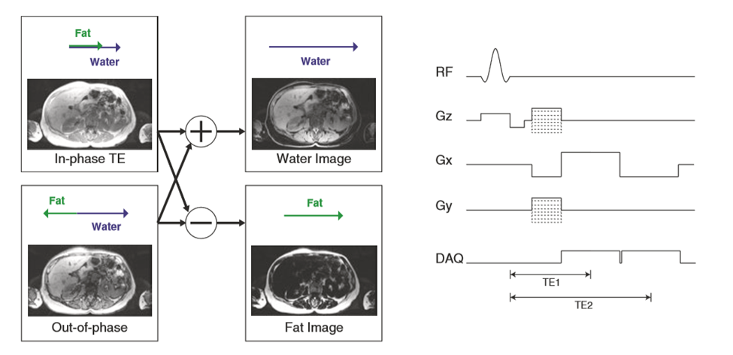
Fat/Water Imaging:
Many MRAC strategies use fat-water separation imaging methods, also known as “Dixon” or “IDEAL” methods. These methods acquire data at multiple echo times (TEs).
For MRAC, typically two-point Dixon approaches are used, as they are faster and the smooth field variation assumption has been shown to be robust for clinical imaging.

Slide 5
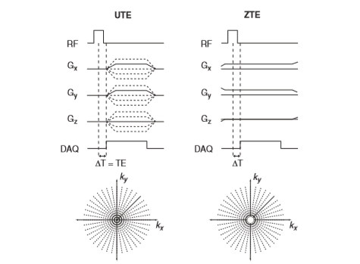
Bone Imaging:
Conventional MR imaging pulse sequences don’t detect any signal from the bone due to its rapid MR signal decay rate. This has been a challenge in PET/MRI because the bone has the largest photon attenuation among all tissue types.
Specialized MRI pulse sequences (ultrashort echo-time (UTE) and zero echo-time (ZTE)) pulse sequences, offer to capture the rapidly decaying signal from the bone and thus are being developed and applied to improve MRAC.

Slide 6
Diffusion-Weighted Imaging:
(DWI) is often achieved by playing out two identical gradient. After the RF excitation pulse, all spins are aligned along the same direction in the transverse plane.
The amount of diffusion weighting is expressed by a quantity called b value

Slide 7
Whole-Body Diffusion-Weighted Imaging
STIR is the preferred fat-suppression method for whole-body imaging due to its robustness to B0 and B1 in homogeneities, despite the lower intrinsic SNR.
Whole-body diffusion imaging is performed axially, with coronal/sagittal reformats generated for the purpose of visualization.

Slide 8
Lung Imaging:
Pulmonary imaging is challenging for MRI due to low tissue density, motion, and rapid signal decay rates.
The (UTE and ZTE) MRI pulse sequences, described previously are also a promising approach for lung imaging.
Compressed sensing and parallel imaging strategies can also be incorporated to improve image quality.

Slide 9
Image contrast in mri
Proton Density
T1 Time
T2 Time

Slide 10
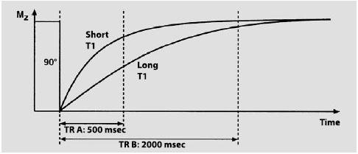
Repetition Time

Slide 11
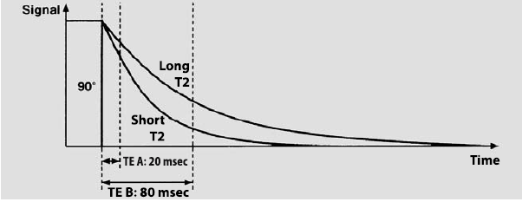
Echo Time

Slide 12
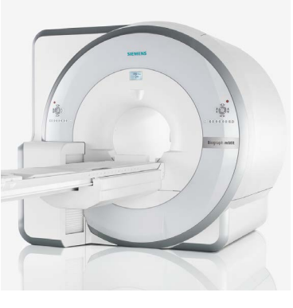
PET/MRI Instrument

Slide 13
MR image Reconstruction
Segmentation-Based MRAC
Bone Attenuation
Truncation Correction

Slide 14
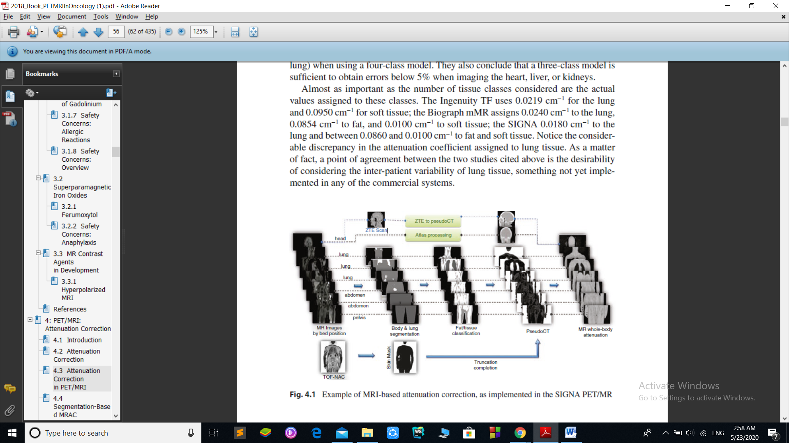
Segmentation-Based MRAC

Slide 15
Bone Attenuation
Why? Difficult to visualize
Problems? Inaccurate head and hip photos
Attenuation correction methods?
The recording of anatomical atlas details on the default MRAC images
the acquisition of short echo time sequences capable of capturing the rapidly decaying signal from the bone

Slide 16
Truncation Correction
Incomplete map of the attenuation
Methods:
PET Segmentation
Joint Estimation of Emission and Transmission

Slide 17
Unsolved ArtifactS
Metal Artifacts
Motion Artifacts
Contrast

Slide 18
Precautions and preparations
Radiation Safety Management
A system acceptance Test (Daily Inspection)
Time and distance between worker and patient
Is the patient suitable or not?

Slide 19
Thank You!

